Slide 1
WELCOME
We Are
Green Programmerz

Slide 2
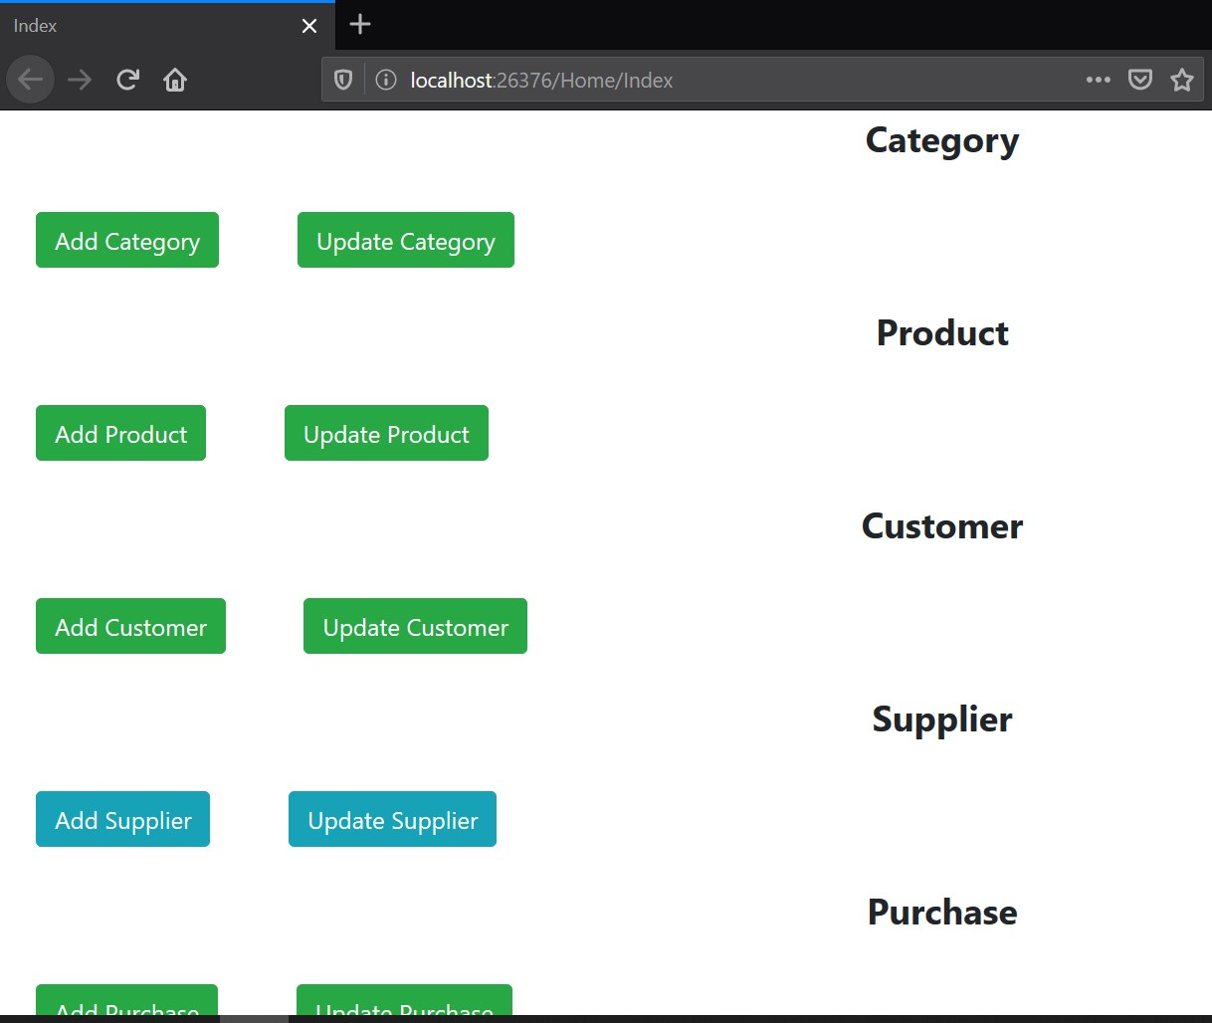
Index

Slide 3
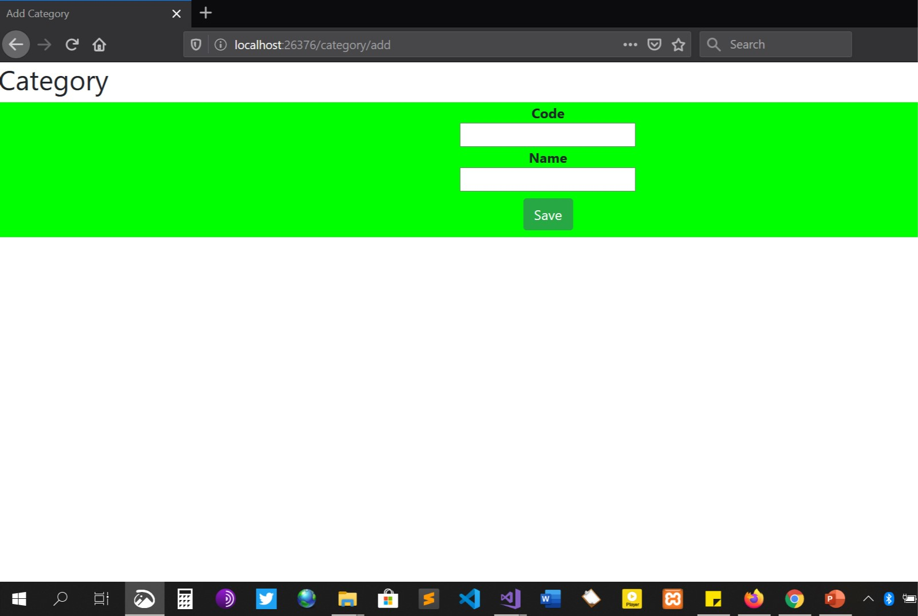
Category Add

Slide 4

Category Update

Slide 5
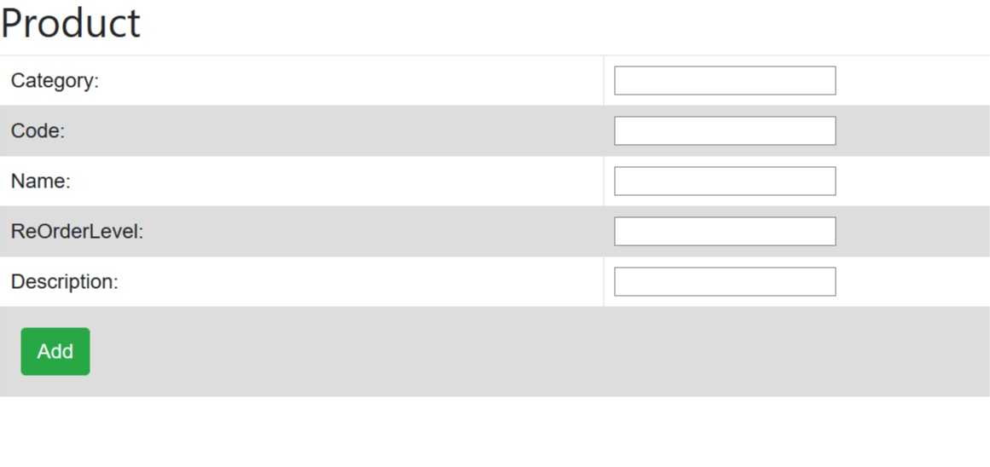
Product Add

Slide 6

Product Update

Slide 7

Customer Add

Slide 8
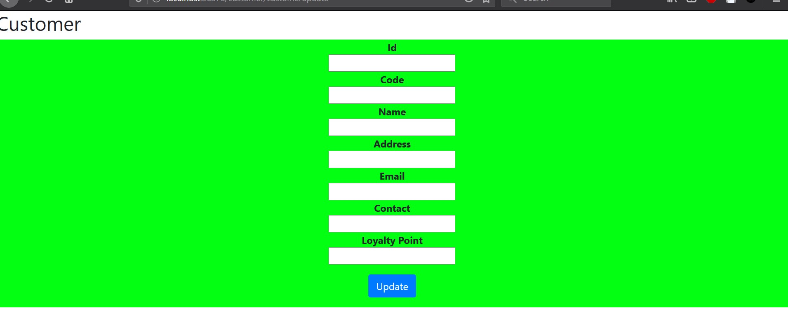
Customer Update

Slide 9
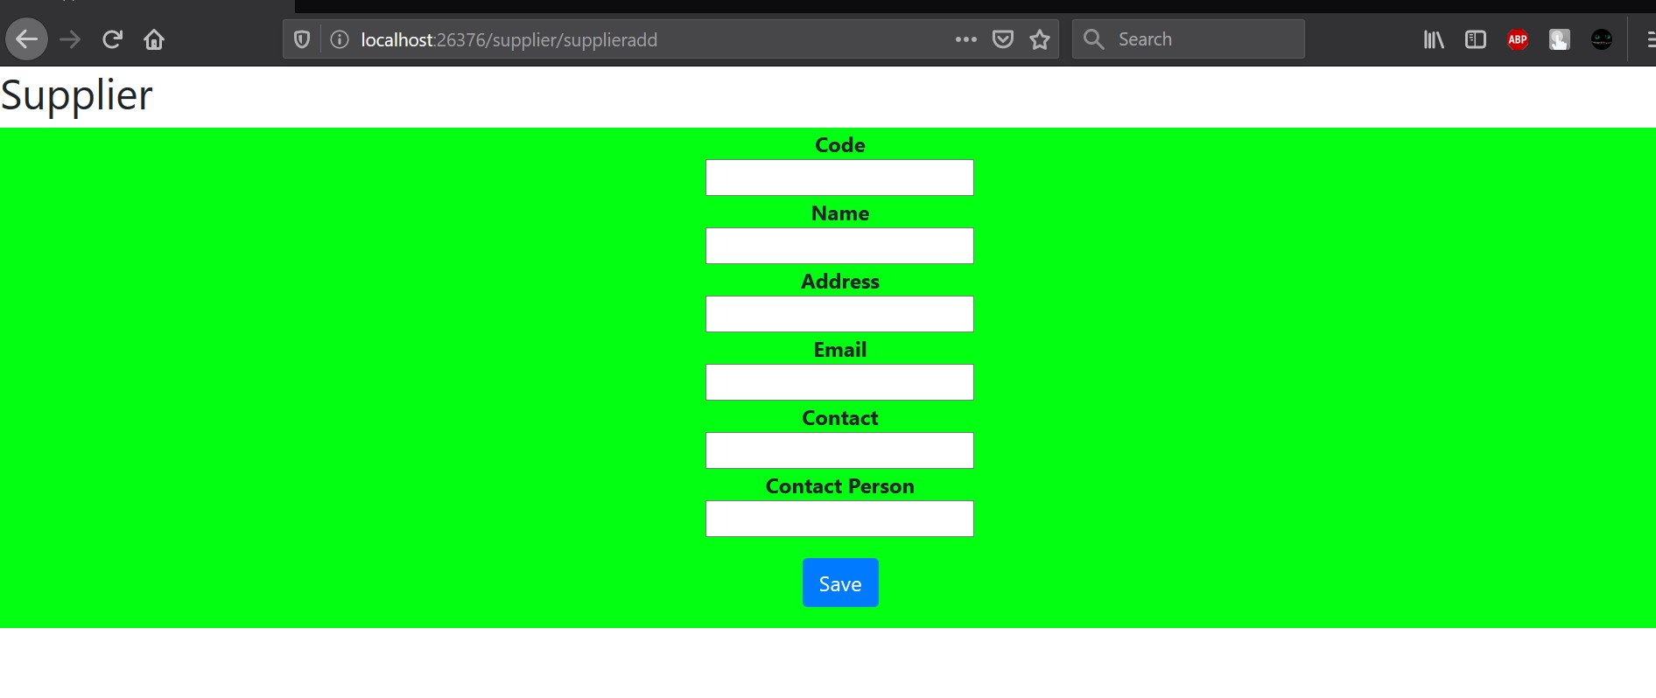
Supplier Add

Slide 10
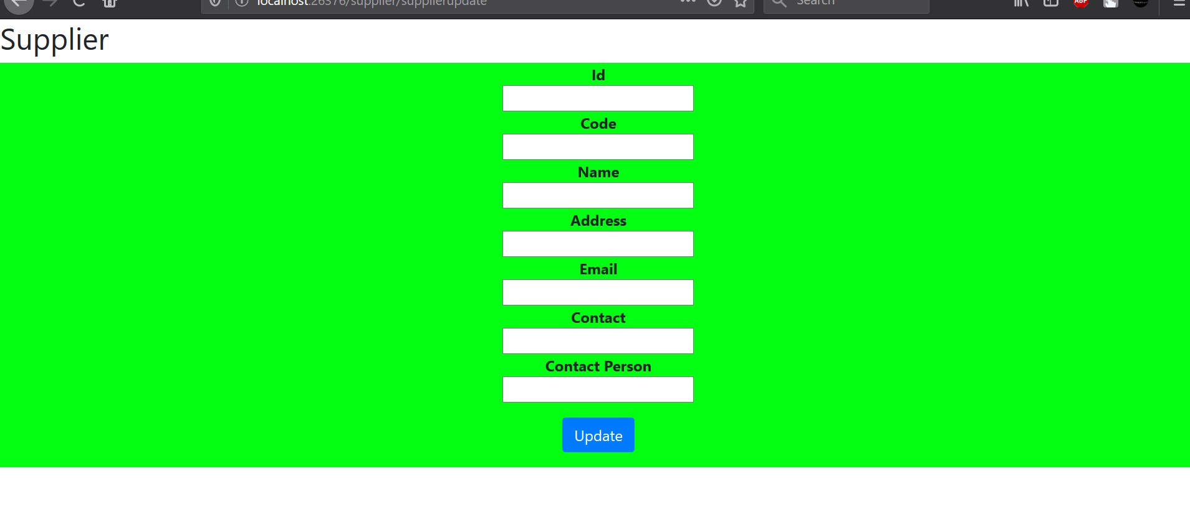
Supplier Update

Slide 11

Last But Not The Least !

